Slide 1

CAPSTONE PROJECT
BY
MAZIYA TABASSUM S

Slide 2
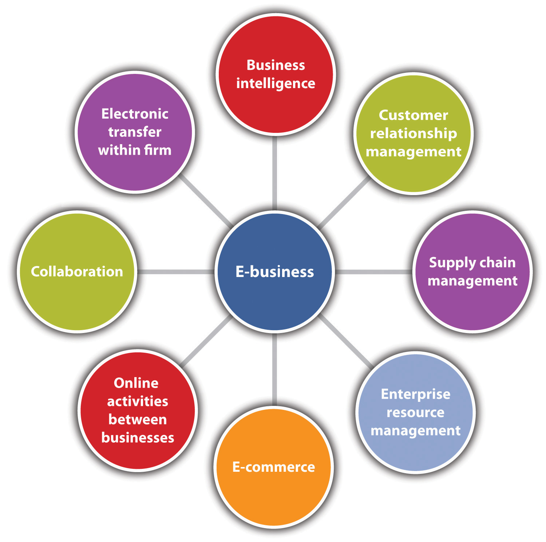

Slide 3
3 STAGES:-
observational, experimental, simulation, and derived.
2. CLEANSING & PROCESSING:
Analyse the data and identify the errors.
Cleanse the data by fixing the errors and replace the blanks cells to 0.
3. VISUALIZATIONS:
Data visualization is the graphical representation of information and data.
By using visual elements like charts , graphs and maps.
We visualize the data from the Power BI.
1.DATA COLLECTION :

Slide 4
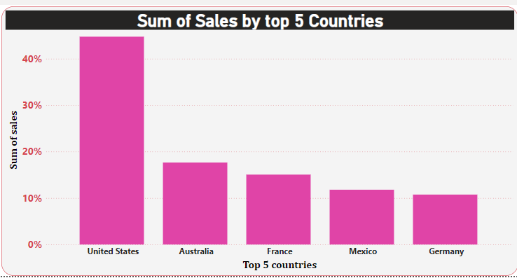
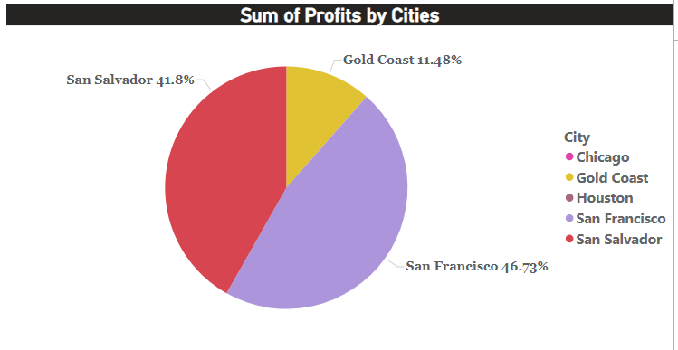
VISUALIZATION REPORT

Slide 5
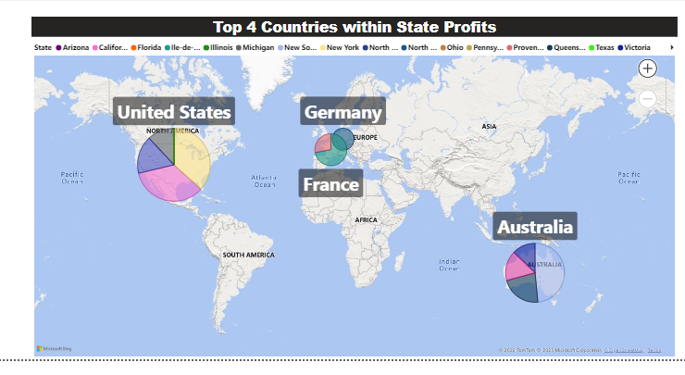
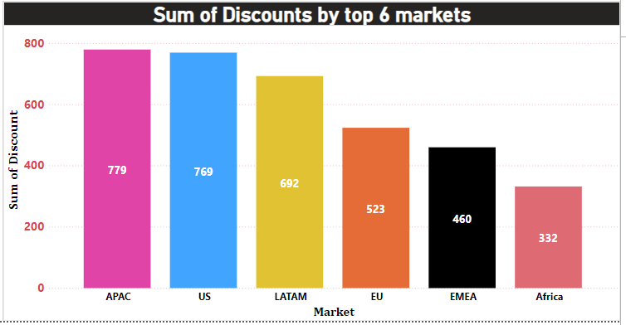
VISUALIZATION REPORT

Slide 6
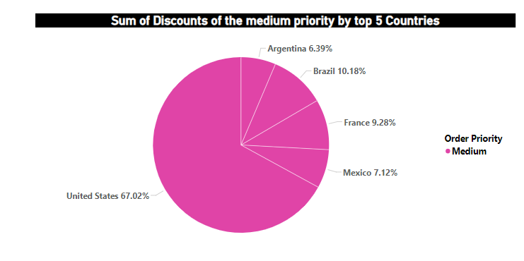
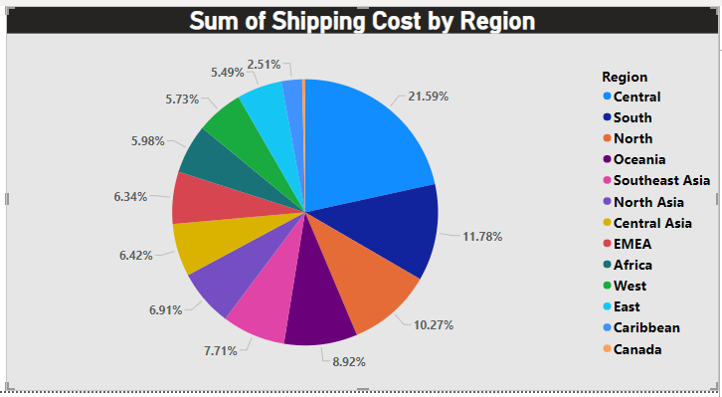
VISUALIZATION REPORT

Slide 7
INSIGHTS:-
Overall Analysis profit was earned by top 3 cities are San Francisco, San Salvador and Gold Coast.
The discount was gained with medium priority by top 5 Countries are United states, Brazil, France, Mexico and Argentina.
The best sales was done with the profit by 5 Countries. They are United states, Australia, France, Mexico and Germany.
The top 6 markets earned with a Discount is APAC, US, LATAM, EU, EMEA and Africa.
The highest shipping cost region is Central region.
Overall visualization, the top most Country is United States.

Slide 8

THANK YOU

